Slide 1
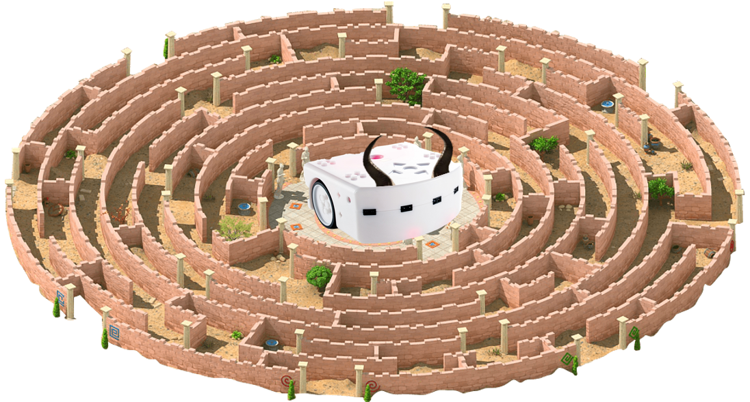
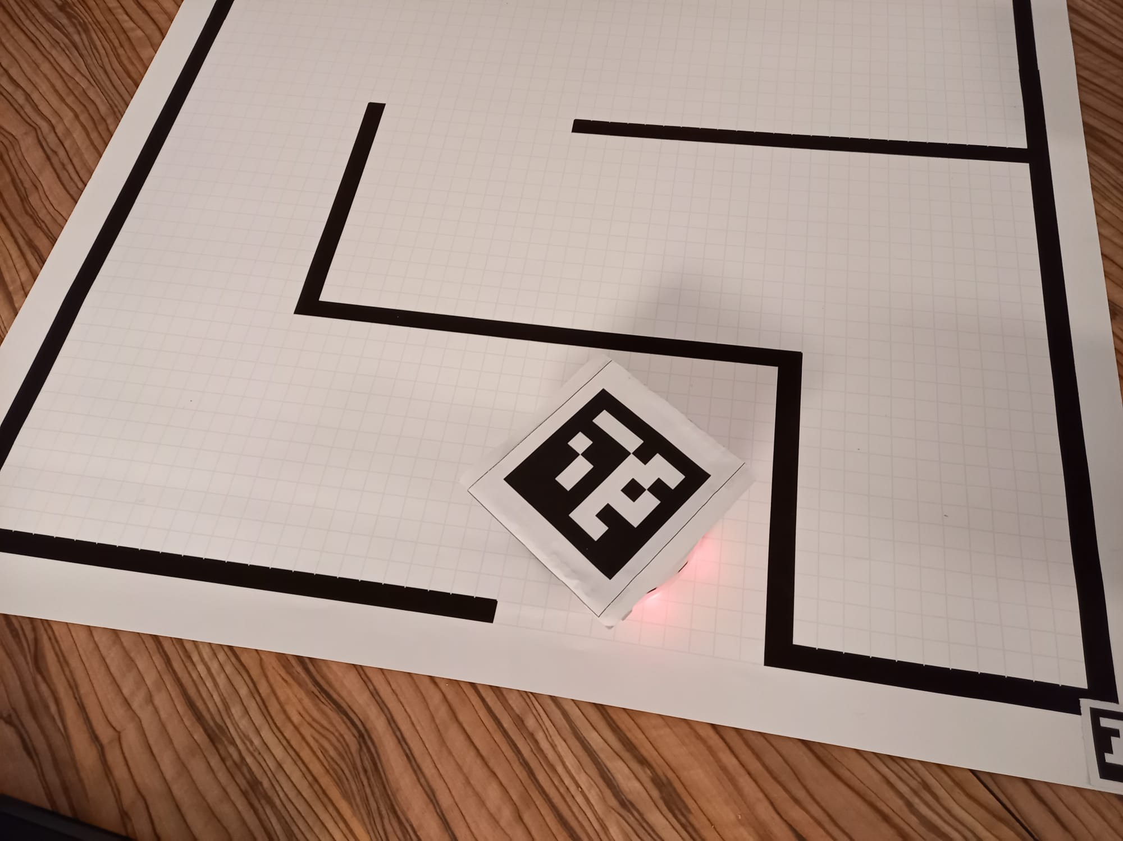
Thyminotaur – Εscaping the maze
Mobile robotics project presentation
Date: December 16th, 2021
Authors:
Stephen Monnet
David Rüegg
Julien Burkhard
Sylvain Jacquart

Slide 2
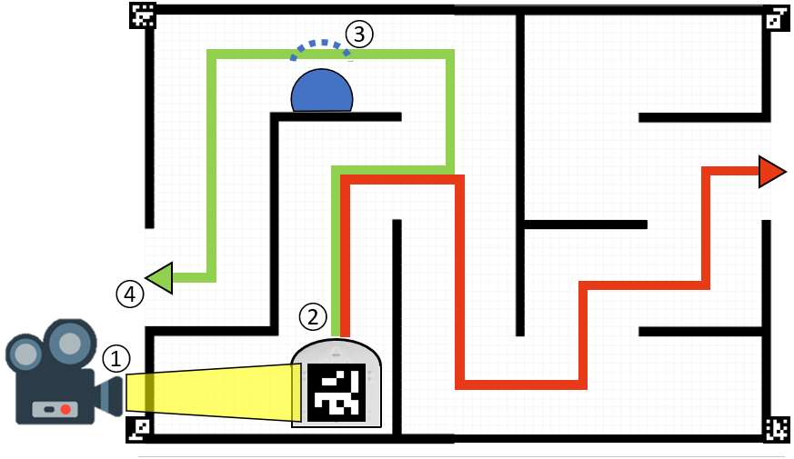
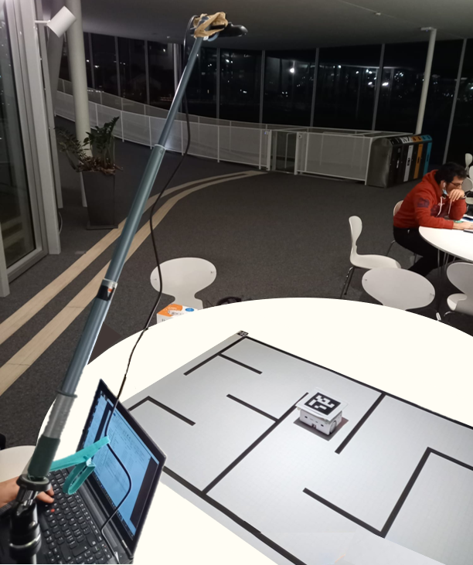
Global project presentation
① Camera detection ② Path to nearest exit
③ Obstacle avoidance ④ Stop at the entrance

Slide 3

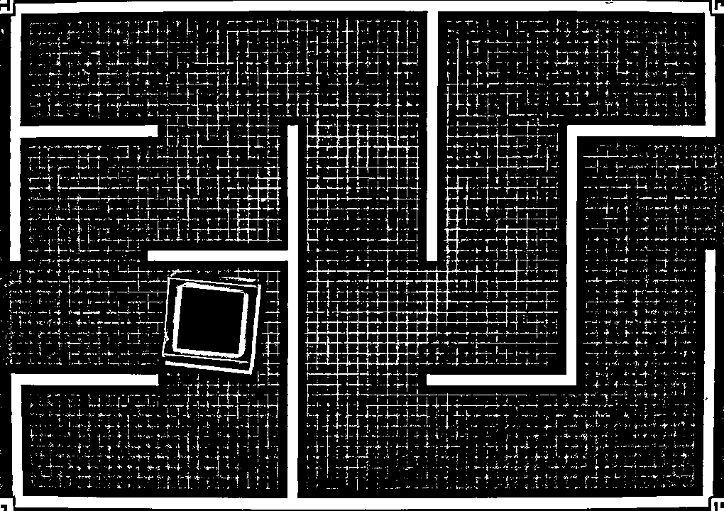
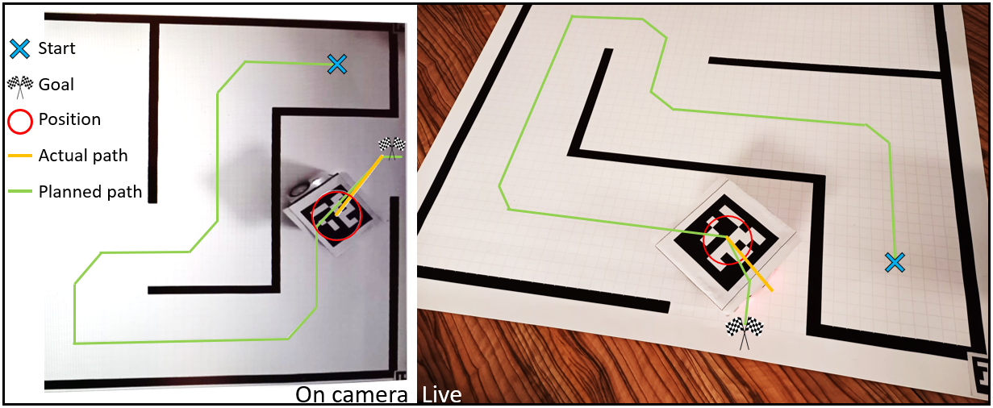
Vision control
Exit n°2
Camera calibration
Global navigation
Exit n°1
Available paths
Discretized map

Slide 4
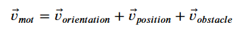
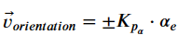
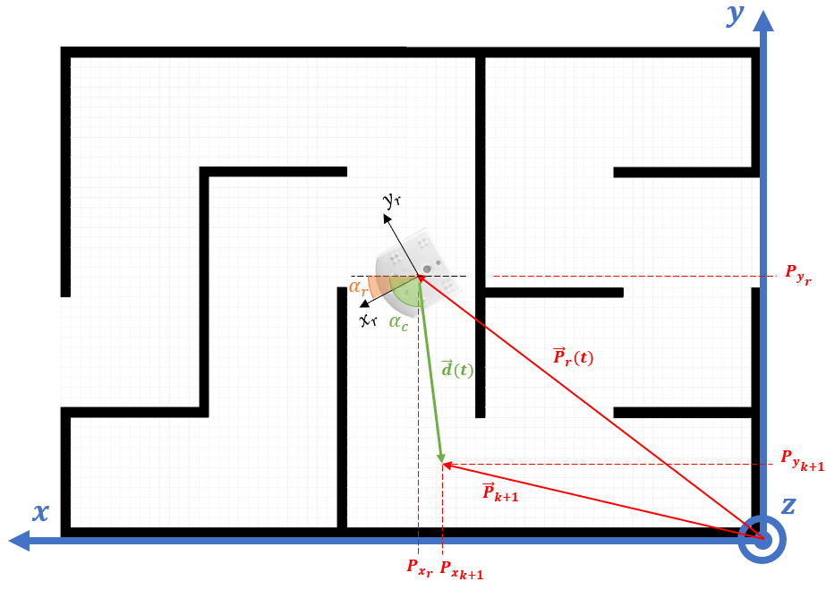
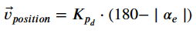

Motion control
Local navigation
Motion control:
$${\vec{v}}_{obstacle}=v_{0}±gain ∙∆(prox[0,…,4])$$

Slide 5
Kalman filtering

Slide 6
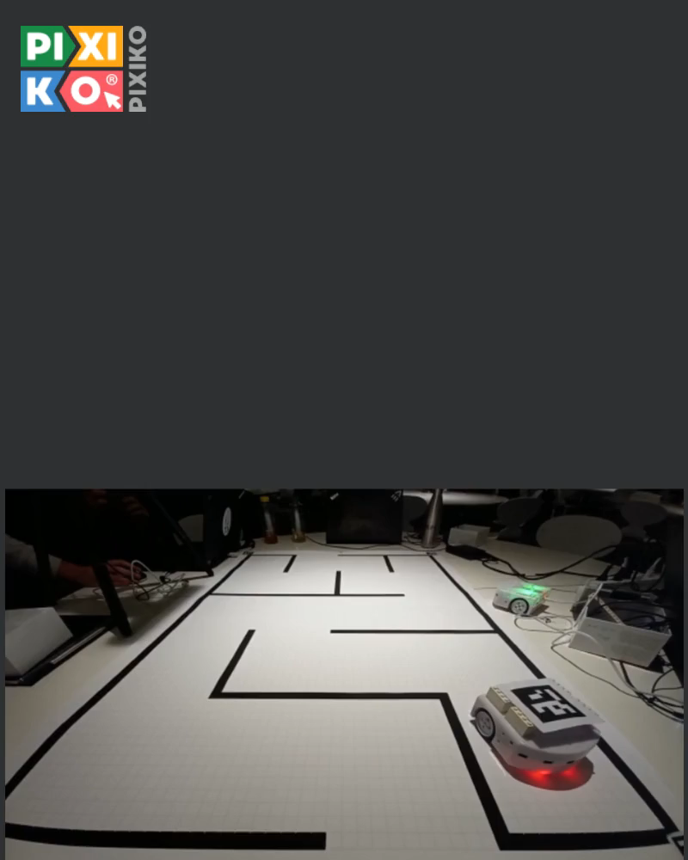

Live demo (back-up video)
Path planning
Closest exit
Obstacle avoidance
No wall touched
Stops at finish line

